Slide 1
Pathology Grading GUI
Technology Review

Slide 2
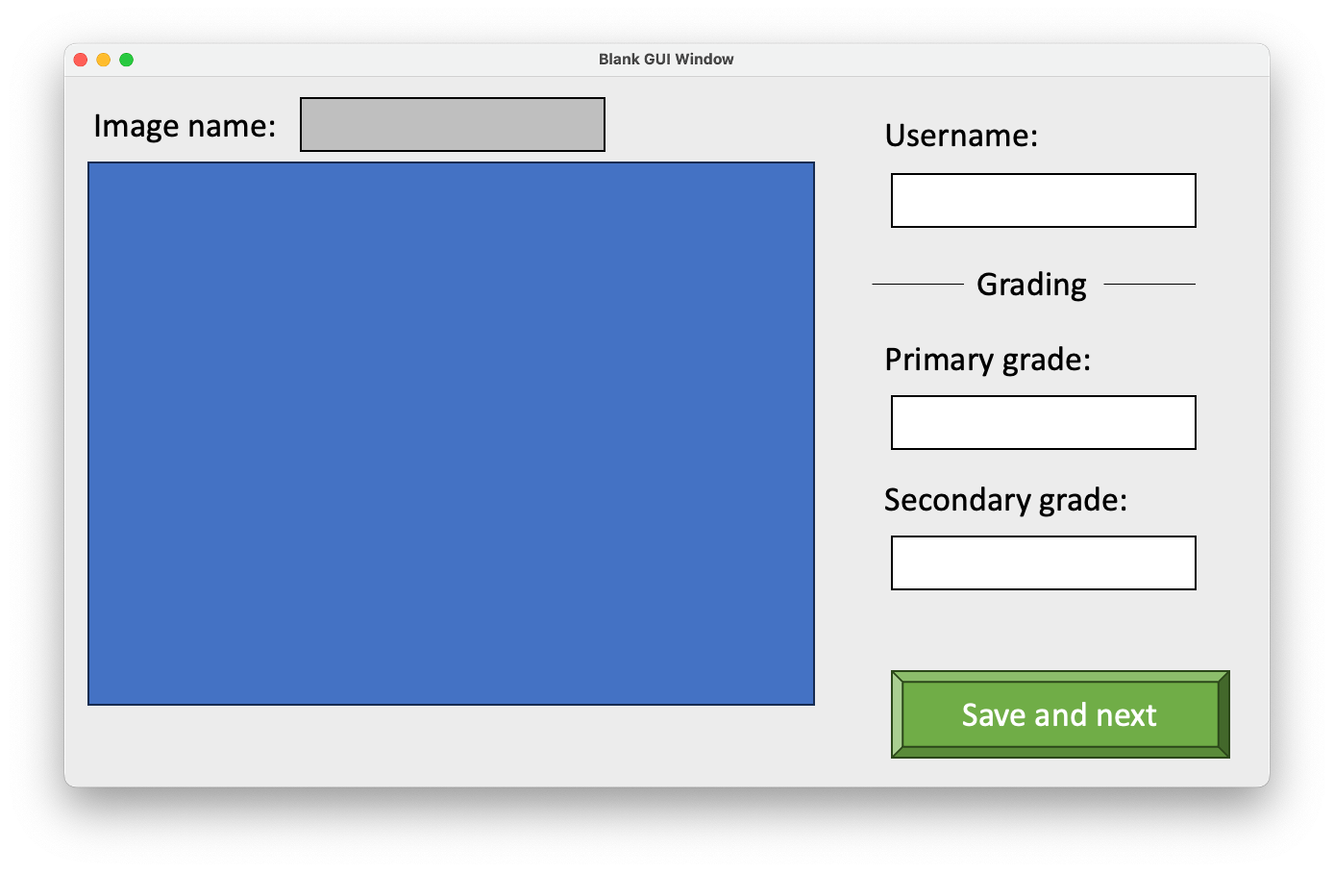
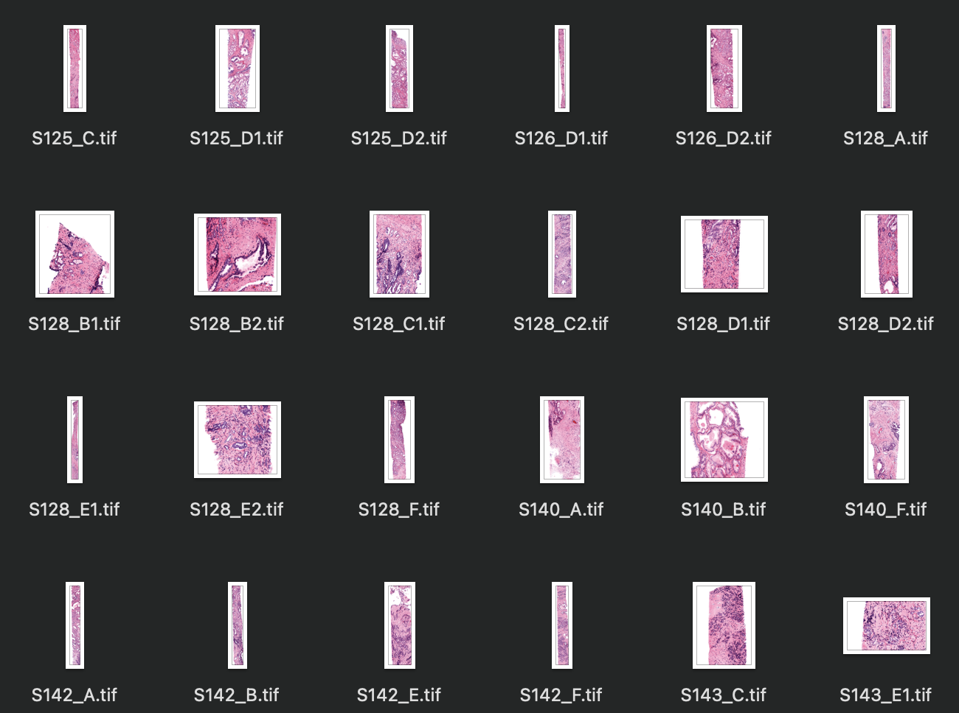
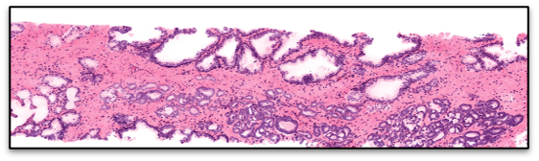
Background
Pathology data
Grading GUI
A user-friendly visualization GUI for pathologists to grade prostate cancer.
Measure the diagnostic accuracy
Measure the inter-rater agreement
Motivation: It costs 40k USD outsourcing it

Slide 3

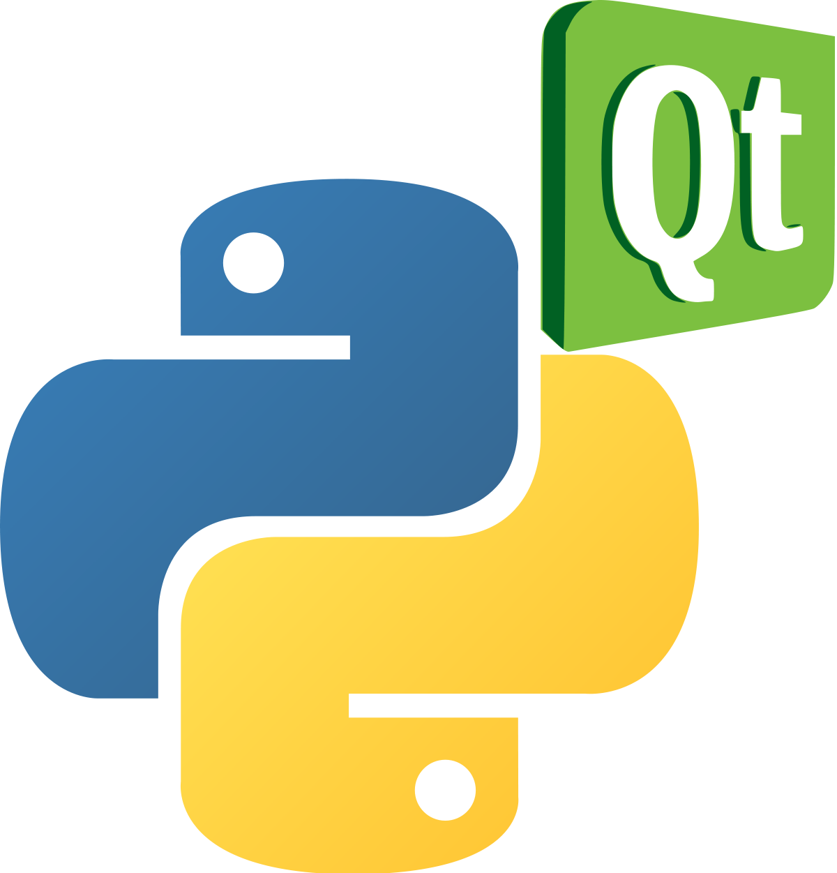

Technology requirements
Able to create user-interface with Python language
Able to integrate with Matplotlib for plotting function
Able to package the application and export it
Potential python packages:

Slide 4
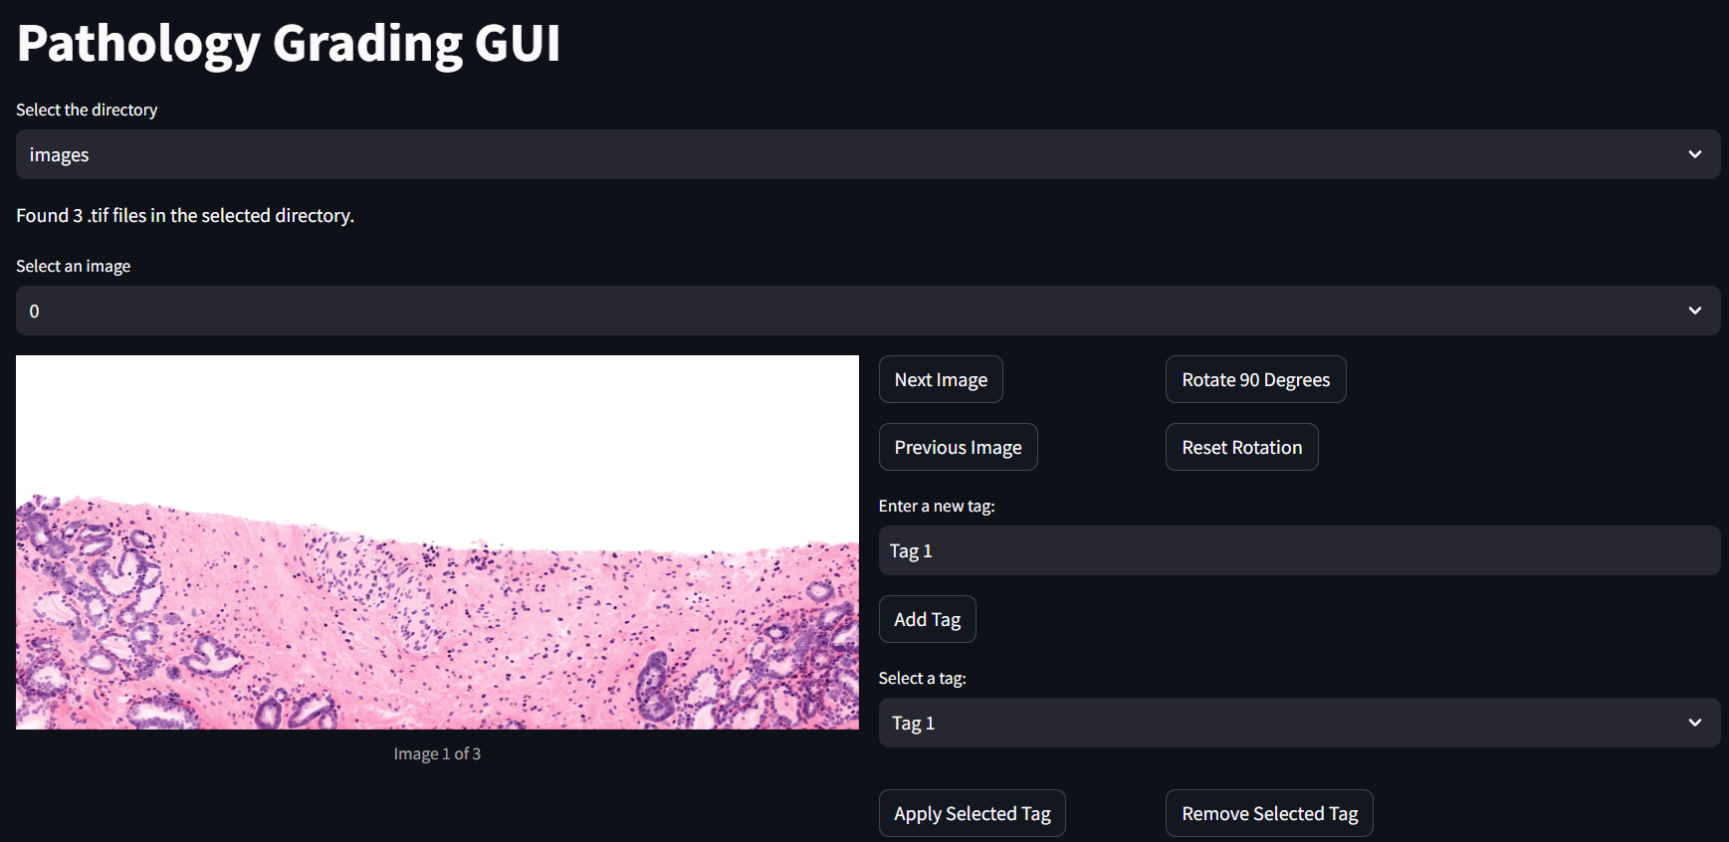
Streamlit
Data analysis tool building platform
Pros:
Easy to share tools with other groups
Easy to download and run in browser
Being rapidly adopted by the Data/ML community
Base front end appearance is sleek and modern
Easy to work with
Cons:
No UI designer tool
Functionality and tools are more limited than PyQt5 or Tkinter

Slide 5
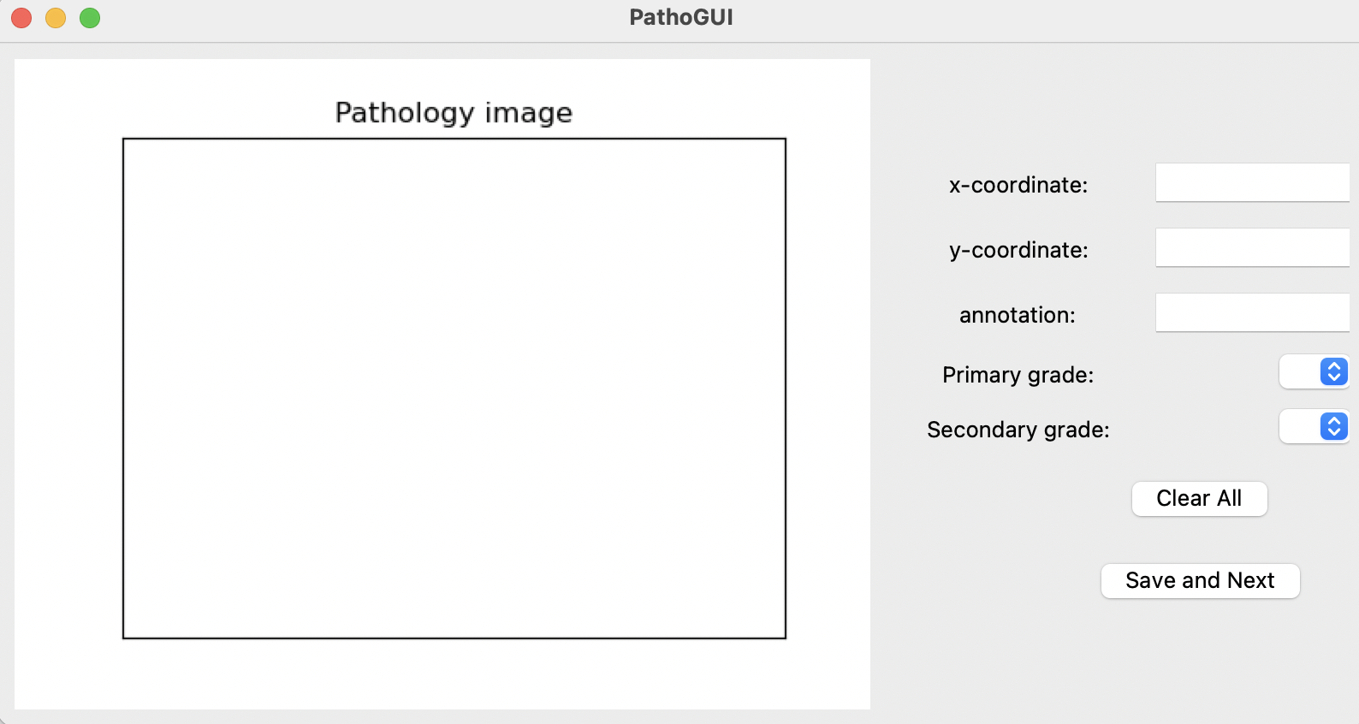
Tkinter
Pros:
Easy to learning
Integrate with Matplotlib
Cross-Platform Compatibility
Open source and Active community
Cons:
Limited Widget Set
Less Features for Advanced GUIs
Event Handling Limitations
Notes:
Tkinter is really easy to learn, and the integration with matplotlib allow us to put the data visualization elements into the GUI. Besides, It is platform-independent, making it easy to deploy the application on various operating systems. But, Tkinter has a more limited set of widgets compared to some other GUI libraries, which might be a drawback if you require a highly specialized interface. It has less features for advanced GUIs which we can choose. For the event handling, it can be considered less flexible compared to some other libraries. Handling complex event-driven scenarios might require more effort.

Slide 6
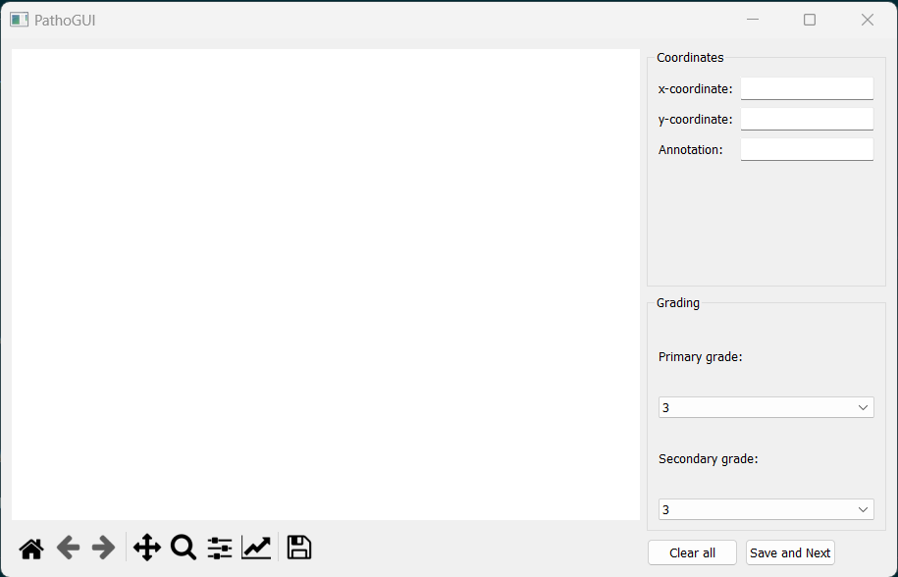
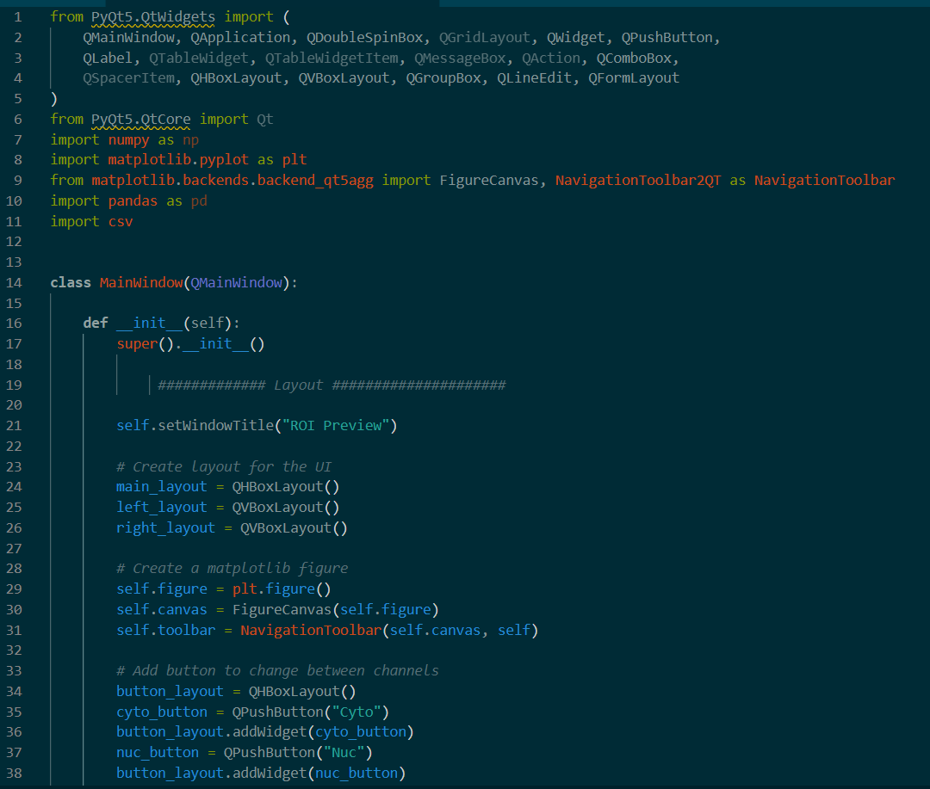
PyQt5
Pros:
Widget: Buttons, labels, windows, dialogs, progress bars etc
QtDesigner tool for design the front-end by drag and drop
Support Model-View-Controller (MVC)
Cons:
The size of the library and its complex
Lack of Python-specific documentation
Notes:
PyQt5
Python develop GUI application
Alternative application development language to C++
Qt Designer
Tool for quickly building GUI with widgets
Simple drag-and-drop interface for laying out components
such as buttons, text fields, combo boxes and more.

Slide 7
Conclusion
Choice: PyQt5
Appeal:
Provide QT design application, which we can drag and drop our interface and convert to code
Can be used on every OS (window, linux, mac)
Drawbacks:
PyQt5 is not as sleek or sharable as Streamlit
Hard to visualize the position of the widgets/object

